Slide 1
Unit-5
Complexity Classes

Slide 2
Complexity Classes
In the field of algorithms, understanding how efficiently an algorithm solves a problem is crucial.
Complexity classes group problems based on the resources (time and space) required to solve them. In simple terms, they help us understand how “hard” a problem is and what kind of algorithms can solve it.
Computational Complexity Theory studies the resources (time, space) required to solve computational problems. It helps us understand which problems can be solved efficiently and which are inherently difficult.
Complexity Class is a set of problems with related complexity. With the help of complexity theory, we try to cover the following.
Problems that cannot be solved by computers.
Problems that can be efficiently solved (solved in Polynomial time) by computers.
Problems for which no efficient solution (only exponential time algorithms) exist.

Slide 3
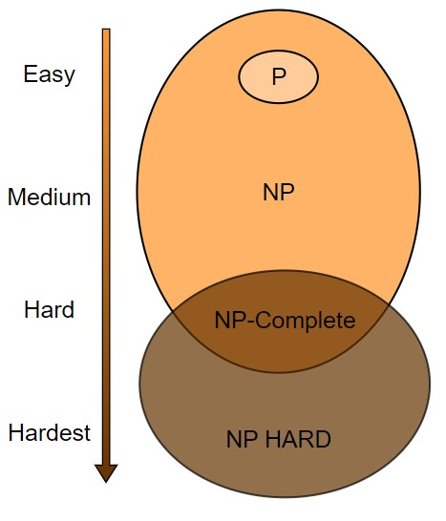
Complexity Classes

Slide 4
Types of Complexity Classes-P Class
P in the P class stands for Polynomial Time. It is the collection of decision problems(problems with a "yes" or "no" answer) that can be solved by a deterministic machine (our computers) in polynomial time.
Features:
The solution to P problems is easy to find.
P is often a class of computational problems that are solvable and tractable. Tractable means that the problems can be solved in theory as well as in practice. But the problems that can be solved in theory but not in practice are known as intractable.
Polynomial time algorithms are considered efficient and practical for real-world use. If a problem is in class P, it means we can solve it relatively quickly even for large inputs.

Slide 5
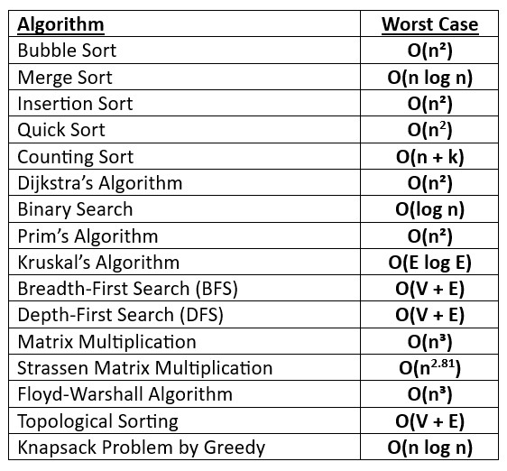
P Class

Slide 6
Types of Complexity Classes-NP Class
Problems in class NP are those where a solution can be verified in polynomial time, but we don’t necessarily know how to solve them efficiently.
The key idea here is that if someone gives us a solution, we can check if it’s correct in a reasonable amount of time.
NP problems are crucial because they are often more challenging to solve but still easy to verify.

Slide 7
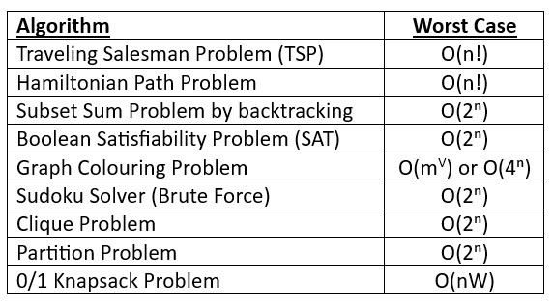
NP Class

Slide 8
Types of Complexity Classes-NP Hard
An NP-hard problem is at least as hard as the hardest problem in NP and it is a class of problems such that every problem in NP reduces to NP-hard.
They are not only hard to solve but are hard to verify as well.
NP-Hard problems are at least as hard as the hardest problems in NP, but they do not have to be decision problems and are not necessarily in NP.
NP-Hard problems might not even be verifiable in polynomial time, and they are not required to have “yes/no” answers.
Real life example
Scheduling a Family Gathering is an NP-hard problem. When organizing a gathering for many family members, each with their own availability, it becomes increasingly difficult to find a time that works for everyone. While it’s easy to accommodate a few people, as the number of participants grows, the combinations of schedules become exponentially complex, making it challenging to find the best solution.

Slide 9
Types of Complexity Classes-NP Hard
Reduction
Convert one problem into another problem in such a way that solving the new problem helps solve the original problem.
process of transforming one problem into another in such a way that a solution to the second problem can be used to solve the first.
If a problem A can be reduced to problem B, it means that solving problem B would allow us to solve problem A as well.

Slide 10
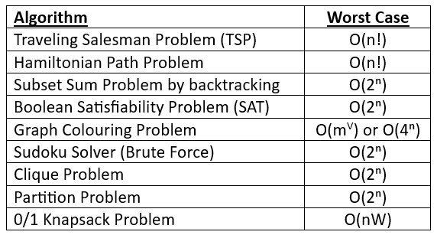
NP Hard

Slide 11
Types of Complexity Classes-NP Complete
A problem is NP-complete if it is both NP and NP-hard. NP-complete problems are the hard problems in NP.
NP-complete problems are special as any problem in NP class can be transformed or reduced into NP-complete problems in polynomial time.
If one could solve an NP-complete problem in polynomial time, then one could also solve any NP problem in polynomial time.

Slide 12
NP Complete
Hamiltonian Cycle.
Satisfiability.
Vertex cover.

Slide 13
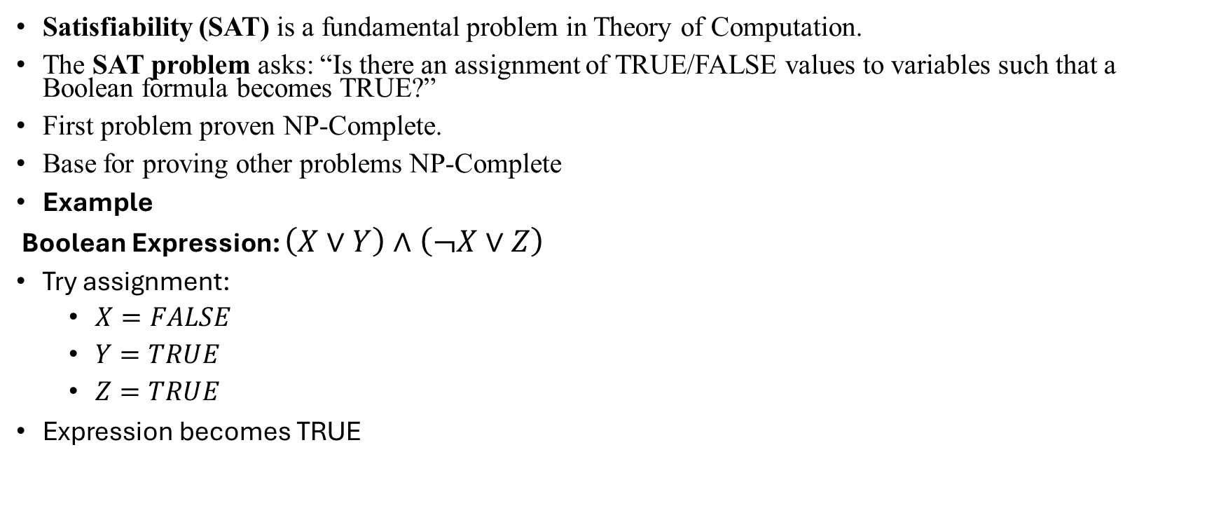
Satisfiability (SAT Problem)
Satisfiability (SAT) is a fundamental problem in Theory of Computation.
The SAT problem asks: “Is there an assignment of TRUE/FALSE values to variables such that a Boolean formula becomes TRUE?”
First problem proven NP-Complete.
Base for proving other problems NP-Complete
Example
Boolean Expression: $\left(X∨Y\right)∧\left(¬X∨Z\right)$
Try assignment:
  $X=FALSE$
  $Y=TRUE$
  $Z=TRUE$
Expression becomes TRUE

Slide 14
Complexity Class | Characteristic feature
P | Easily solvable in polynomial time.
NP | Yes, answers can be checked in polynomial time.
NP-hard | All NP-hard problems are not in NP and it takes a long time to check them.
NP-complete | A problem that is NP and NP-hard is NP-complete.

Slide 15
Examples of P and NP Problem
Examples of P Problems
Searching (Binary Search)
Sorting (Merge Sort, Quick Sort)
Shortest Path (Dijkstra's Algorithm)
Minimum/Maximum finding
Graph traversal (BFS, DFS)

Slide 16
Real-Life Examples of P
Finding a name in a sorted list
Arranging marks in order
Finding shortest route on maps
Finding highest marks in class

Slide 17
Examples of NP Problems
Travelling Salesman Problem
Knapsack Problem
SAT Problem
Graph Coloring

Slide 18
Real-Life Examples of NP
Checking if a route satisfies distance limit
Verifying selected items fit budget
Checking exam schedule conflicts
Validating password/logic constraints

